Slide 1
Chapter 8 Epidemics on General Graphs
2016.11.14
Jungseul Ok

Slide 2










Spread over Social Network
Diffusion by interaction among individuals
New advertising opportunity via social network
Virus
Rumor
OS
Smartphone
Political Party
Survey: 1,713 companies in USA [Salseforce 2015]
72% will increase cost for social marketing
78% have a dedicated social media team
70% believe social marketing is core
Online Social Network Services
Notes:
우선 소셜 네트워크 연구 배경에대해서 간략히 먼저 소개해 드리겠습니다.
실제 생활에서 사람들 사이의 사회관계망을 통해 다양한 것들이 퍼지는데, 예를 들면 메르스와 같은 전염병, 카톡찌라시와 같은 소문, 신제품에 대한 의견 뿐만 아니라 정치적인 의견도 소셜 네트워크를 통해서 퍼지는 것을 쉽게 볼 수 있습니다.
최근들어서는 페이스북이나 트위터와 같은 온라인 소셜 네트워크를 통해 더 많은 정보가 더 많은 사람들 사이에서 빠르고 쉽게 공유되고 있습니다.
동시에, 온라인 소셜 네트워크 서비스의 발달로, 누가 친구고 어떤 대화를 주로 주고 받는지 등의 데이터가 수집되어지고,
이렇게 수집된 데이터를 분석하고 소셜 네트워크를 활용하는 소셜 마케팅이라는 새로운 마케팅 기법이 등장하게 됩니다.
실제로 2015년도에 미국 기업을 대상으로한 한 설문에 따르면 70퍼센트가 넘는 기업이 소셜 마케팅이 그들의 핵심 마케팅 수단이라고 답했습니다.

Slide 3
Outline
Two Classical Epidemic Models
S: susceptible, I: infected, R: removed
SIR model (a.k.a. Reed-Frost model)
SIS model
Analysis in General Graphs
Upper and lower bounds on degree of diffusion in terms of graph theoretic parameters and model parameters
SIR model: spread size
SIS model: extinction time
Analysis in Specific Graphs
Complete graph
E-R graph, star-shaped graph, hypercube graph

Slide 4
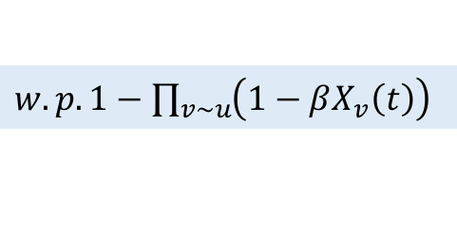
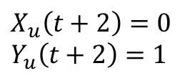
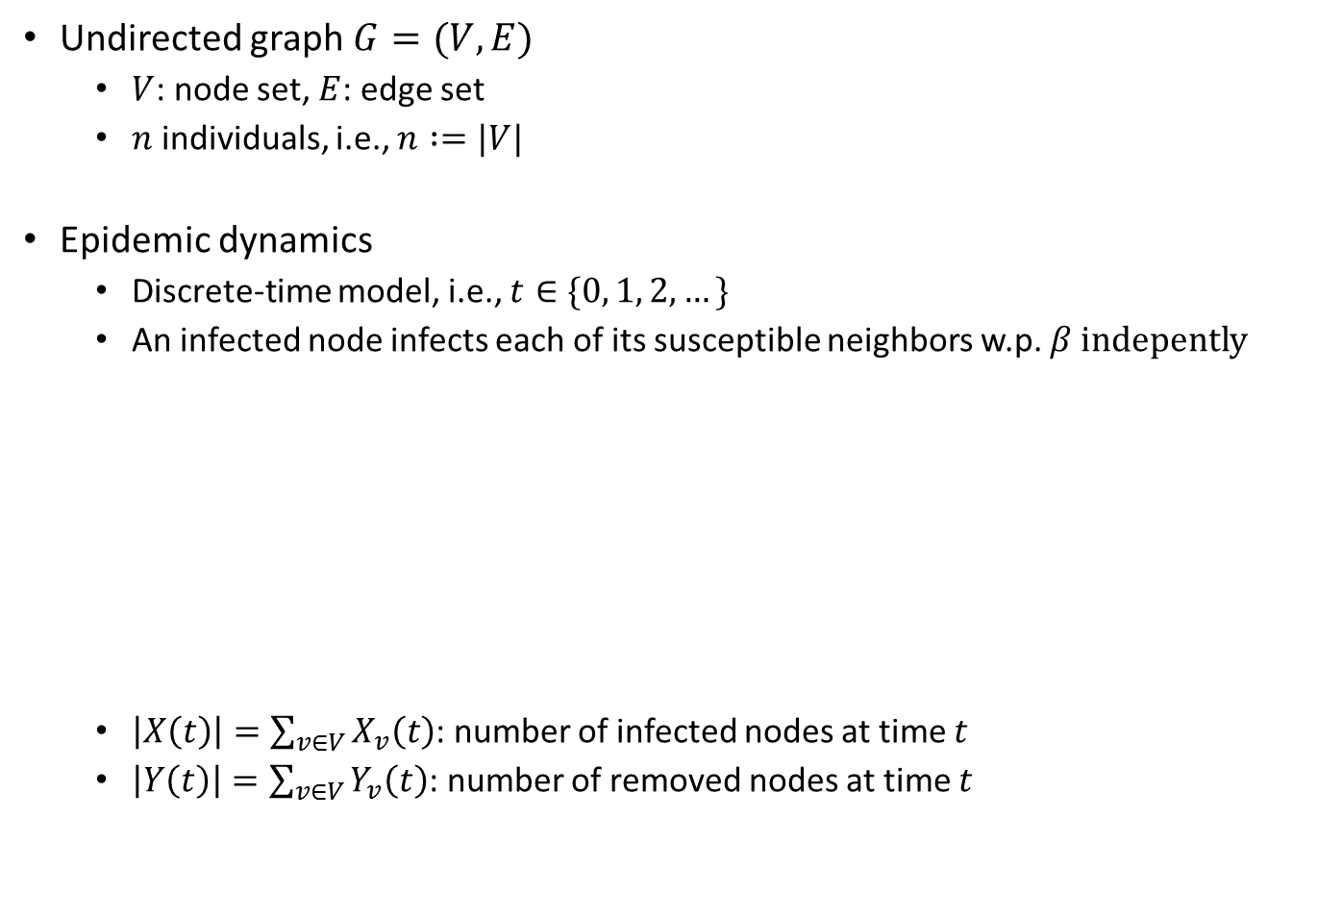
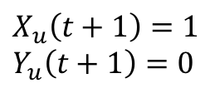
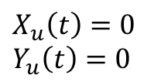

SIR Model, a.k.a. Reed-Frost Model
Undirected graph $G=(V, E)$
$V$: node set, $E$: edge set
$n$ individuals, i.e., $n :=|V|$
Epidemic dynamics
Discrete-time model, i.e., $t∈\{0, 1, 2, …\}$
An infected node infects each of its susceptible neighbors w.p. $β$ indepently
$\left|X\left(t\right)\right|=\sum_{v∈V}{X_{v}\left(t\right)}$: number of infected nodes at time $t$
$\left|Y\left(t\right)\right|=\sum_{v∈V}{Y_{v}\left(t\right)}$: number of removed nodes at time $t$
$w.p. 1−\prod_{v\sim u}{\left(1−βX_{v}\left(t\right)\right)}$
$$w.p. 1$$
(S)usceptible
(I)nfected
(R)emoved
$$X_{u}\left(t\right)=0 \\ Y_{u}\left(t\right)=0$$
$$X_{u}\left(t+1\right)=1 \\ Y_{u}\left(t+1\right)=0$$
$$X_{u}\left(t+2\right)=0 \\ Y_{u}\left(t+2\right)=1$$

Slide 5
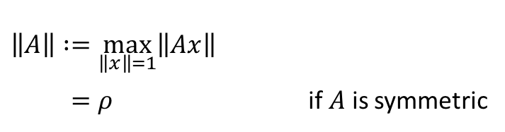
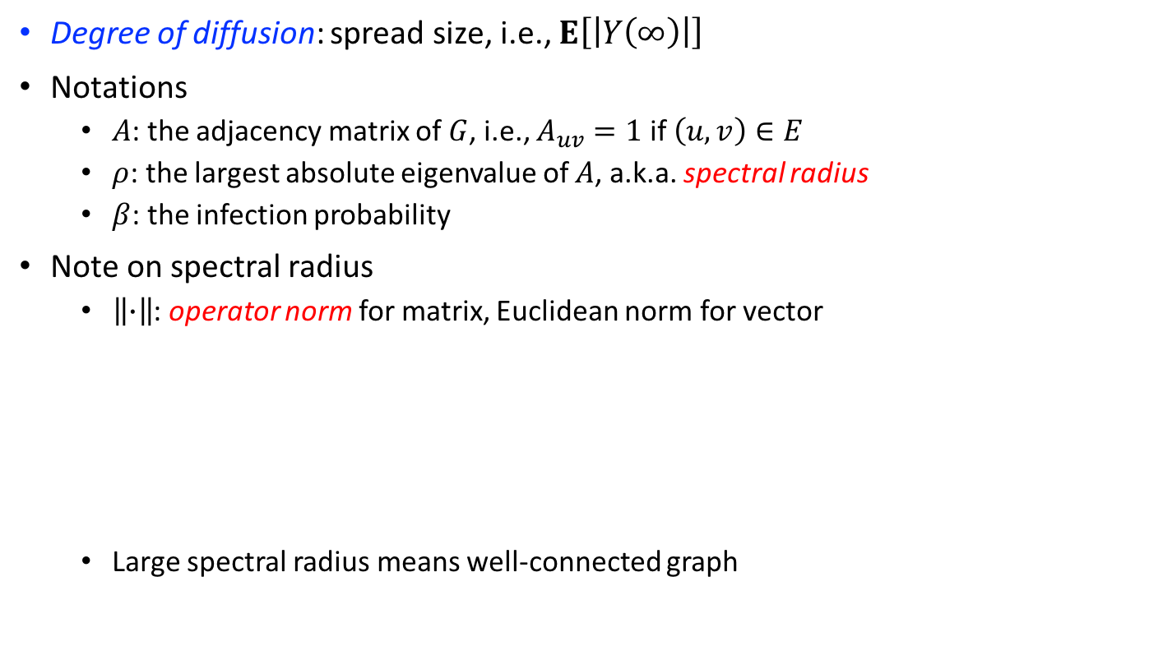
Analysis on SIR Model
Degree of diffusion: spread size, i.e., $Ε\left[\left|Y\left(∞\right)\right|\right]$
Notations
$A$: the adjacency matrix of $G$, i.e., $A_{uv}=1$ if $\left(u,v\right)∈E$
$ρ$: the largest absolute eigenvalue of $A$, a.k.a. spectral radius
$β$: the infection probability
Note on spectral radius
$\left\|∙\right\|$: operator norm for matrix, Euclidean norm for vector
Large spectral radius means well-connected graph
$\left\|A\right\| :=\max_{\left\|x\right\|=1}\left\|Ax\right\|$
$=ρ$ if $A$ is symmetric

Slide 6

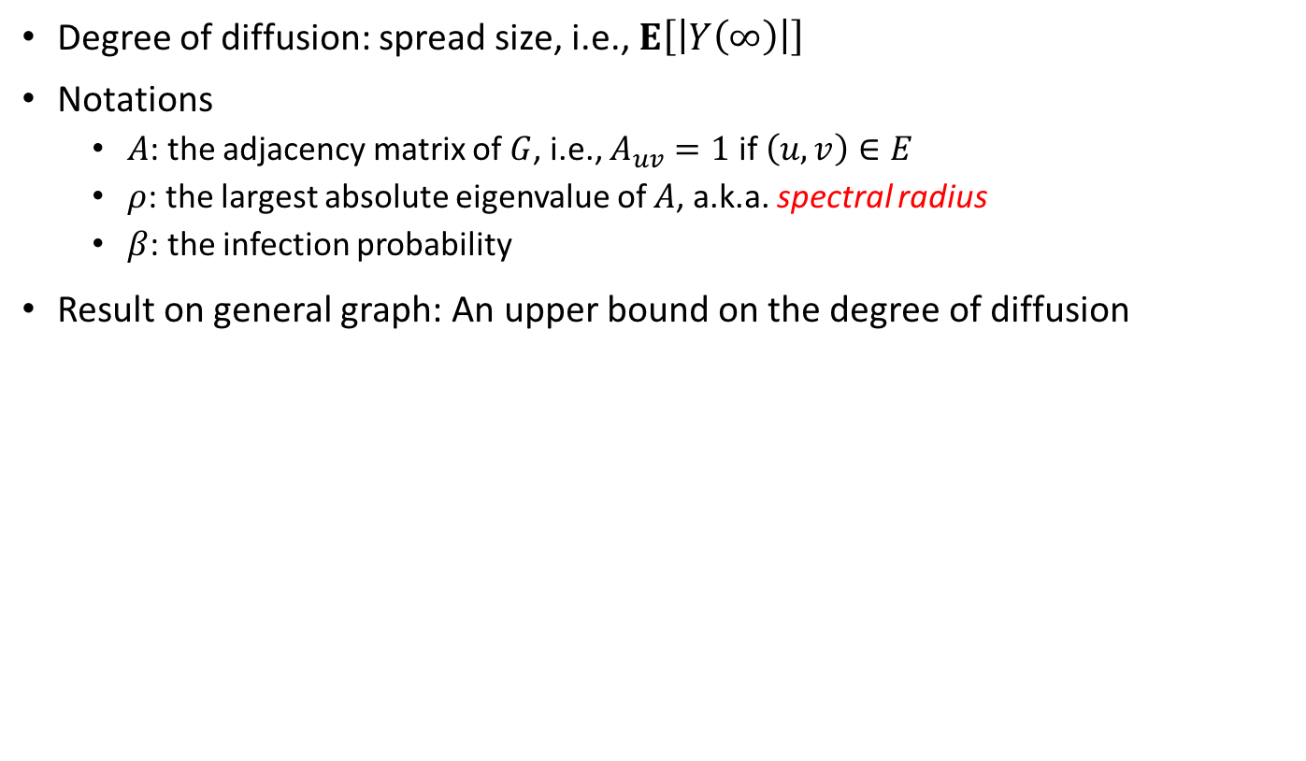
Analysis on SIR Model
Degree of diffusion: spread size, i.e., $Ε\left[\left|Y\left(∞\right)\right|\right]$
Notations
$A$: the adjacency matrix of $G$, i.e., $A_{uv}=1$ if $\left(u,v\right)∈E$
$ρ$: the largest absolute eigenvalue of $A$, a.k.a. spectral radius
$β$: the infection probability
Result on general graph: An upper bound on the degree of diffusion

Slide 7
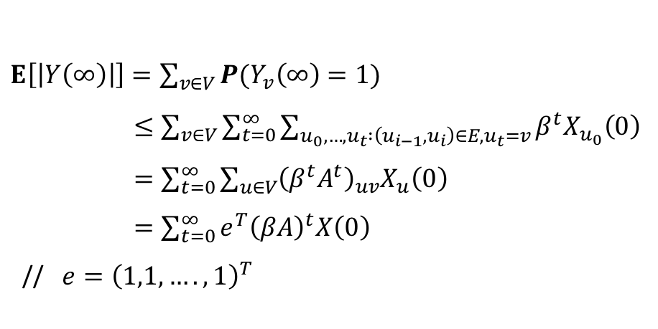
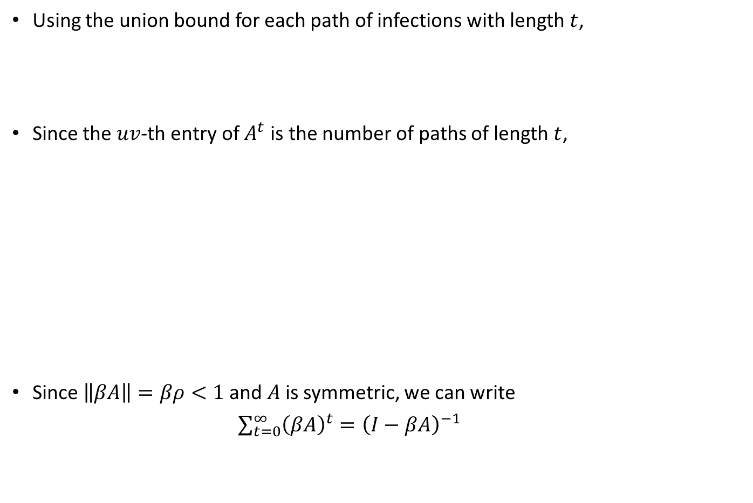
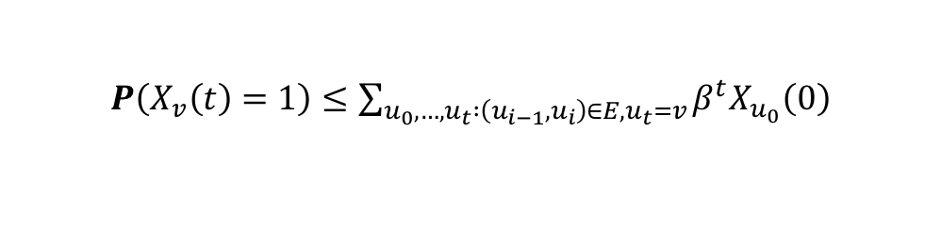
Proof of Theorem 8.1 (1)
Using the union bound for each path of infections with length $t$,
Since the $uv$-th entry of $A^{t}$ is the number of paths of length $t$,
Since $\left\|βA\right\|=βρ<1$ and $A$ is symmetric, we can write $\sum_{t=0}^{∞}{{\left(βA\right)}^{t}}={\left(I−βA\right)}^{−1}$
$P\left(X_{v}\left(t\right)=1\right)≤\sum_{u_{0}, …, u_{t} :\left(u_{i−1}, u_{i}\right)∈E, u_{t}=v}{β^{t}X_{u_{0}}\left(0\right)}$
$E\left[\left|Y\left(∞\right)\right|\right]=\sum_{v∈V}{P(Y_{v}\left(∞\right)=1)}$
$≤\sum_{v∈V}{\sum_{t=0}^{∞}{\sum_{u_{0}, …, u_{t} :\left(u_{i−1}, u_{i}\right)∈E, u_{t}=v}{β^{t}X_{u_{0}}\left(0\right)}}}$
$=\sum_{t=0}^{∞}{\sum_{u∈V}{{\left(β^{t}A^{t}\right)}_{uv}X_{u}\left(0\right)}}$
$=\sum_{t=0}^{∞}{e^{T}{\left(βA\right)}^{t}X\left(0\right)}$
// $e={\left(1,1,…., 1\right)}^{T}$

Slide 8
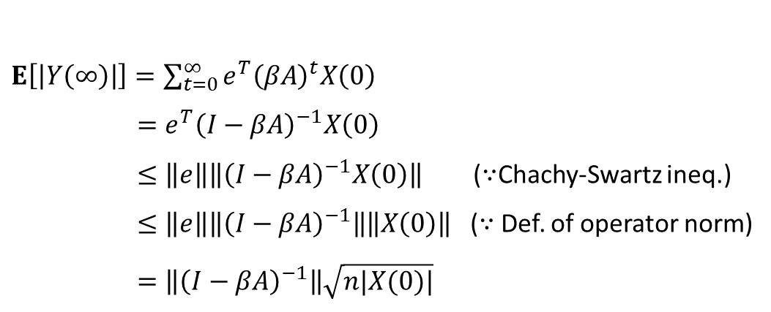
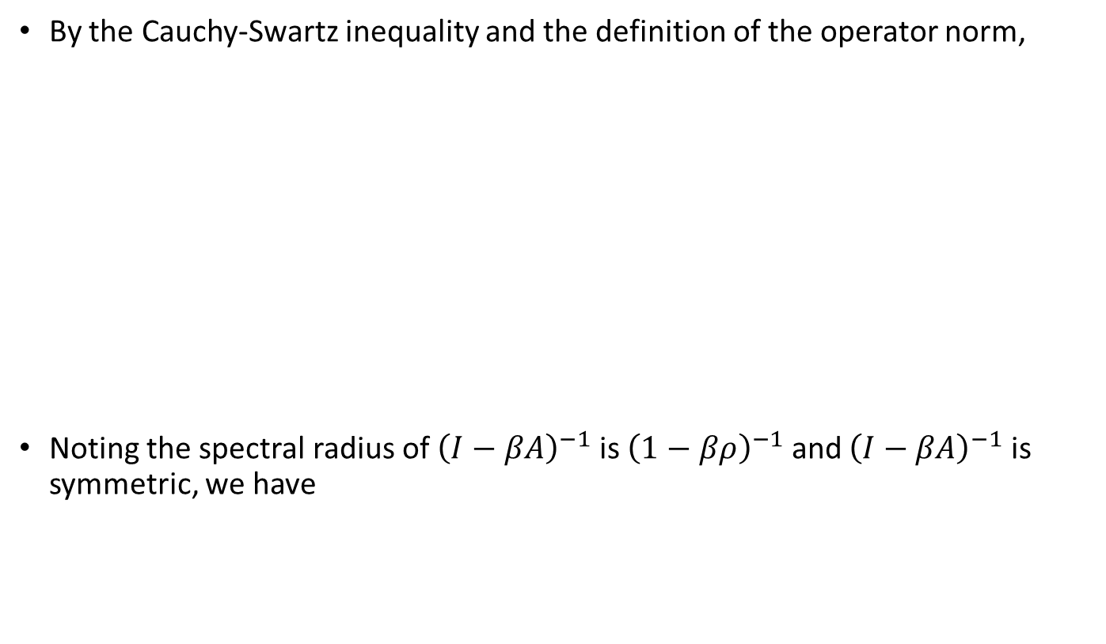
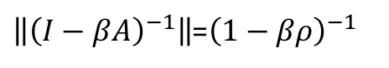
Proof of Theorem 8.1 (2)
By the Cauchy-Swartz inequality and the definition of the operator norm,
Noting the spectral radius of ${\left(I−βA\right)}^{−1}$ is ${\left(1−βρ\right)}^{−1}$ and ${\left(I−βA\right)}^{−1}$ is symmetric, we have
$E\left[\left|Y\left(∞\right)\right|\right]=\sum_{t=0}^{∞}{e^{T}{\left(βA\right)}^{t}X\left(0\right)}$
$=e^{T}{\left(I−βA\right)}^{−1}X\left(0\right)$
$≤\left\|e\right\|\left\|{\left(I−βA\right)}^{−1}X\left(0\right)\right\|$ ($∵$Chachy-Swartz ineq.)
$≤\left\|e\right\|\left\|{\left(I−βA\right)}^{−1}\right\|\left\|X\left(0\right)\right\|$ ($∵$ Def. of operator norm)
$=\left\|{\left(I−βA\right)}^{−1}\right\|\sqrt{n|X(0)|}$
$\left\|{\left(I−βA\right)}^{−1}\right\|$=${\left(1−βρ\right)}^{−1}$

Slide 9
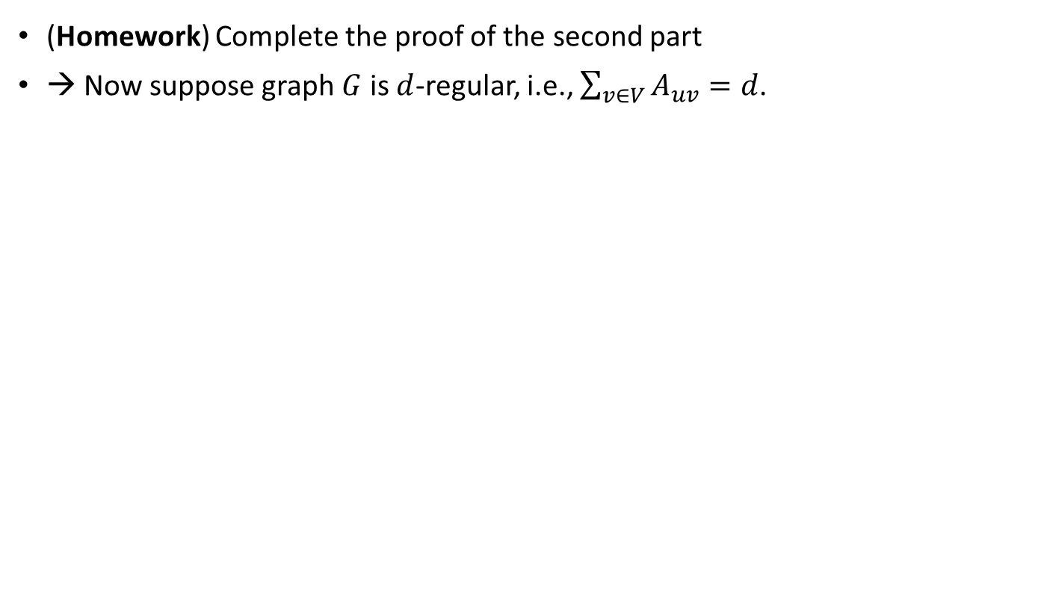
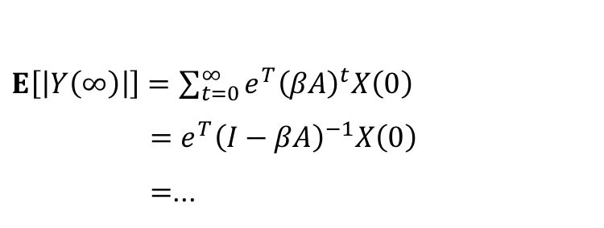
Proof of Theorem 8.1 (3)
(Homework) Complete the proof of the second part
→ Now suppose graph $G$ is $d$-regular, i.e., $\sum_{v∈V}{A_{uv}}=d$.
$E\left[\left|Y\left(∞\right)\right|\right]=\sum_{t=0}^{∞}{e^{T}{\left(βA\right)}^{t}X\left(0\right)}$
$=e^{T}{\left(I−βA\right)}^{−1}X\left(0\right)$
$=$...

Slide 10
Outline
Two Classical Epidemic Models
S: susceptible, I: infected, R: removed
SIR model (a.k.a. Reed-Frost model)
SIS model
Analysis in General Graphs
Upper and lower bounds on degree of diffusion in terms of graph theoretic parameters and model parameters
SIR model: spread size
SIS model: extinction time
Analysis in Specific Graphs
Complete graph
E-R graph, star-shaped graph, hypercube graph

Slide 11
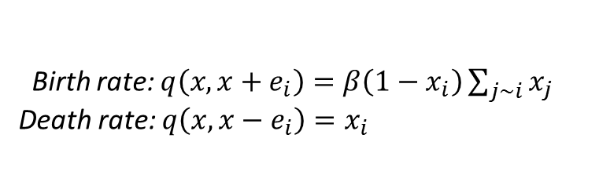
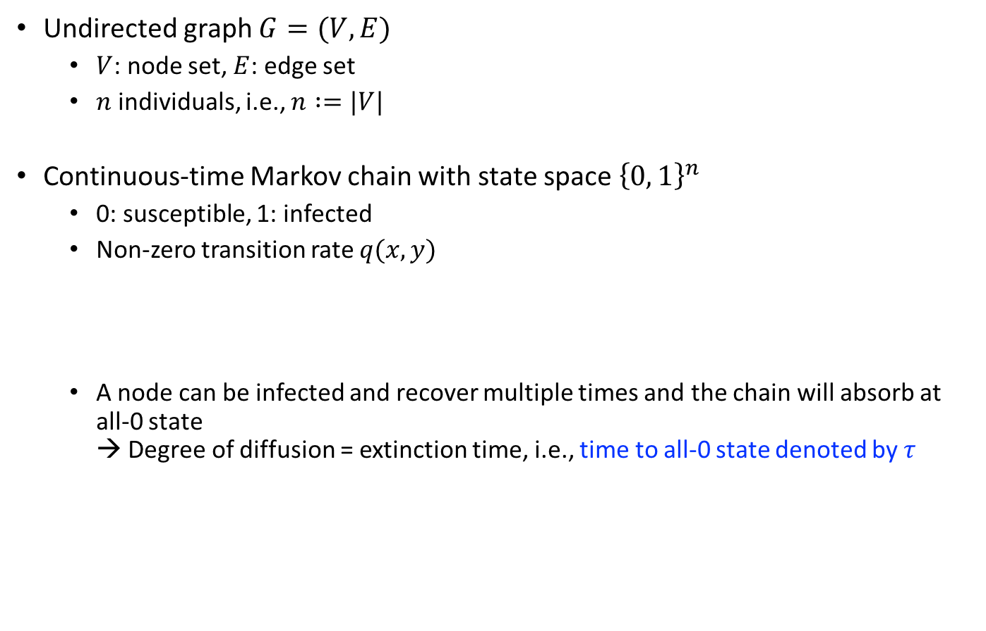
SIS Model, e.g., flu
Undirected graph $G=(V, E)$
$V$: node set, $E$: edge set
$n$ individuals, i.e., $n :=|V|$
Continuous-time Markov chain with state space ${\left\{0, 1\right\}}^{n}$
0: susceptible, 1: infected
Non-zero transition rate $q(x, y)$
A node can be infected and recover multiple times and the chain will absorb at all-0 state → Degree of diffusion = extinction time, i.e., time to all-0 state denoted by $τ$
Birth rate: $q\left(x,x+e_{i}\right)=β\left(1−x_{i}\right)\sum_{j\sim i}{x_{j}}$
Death rate: $q\left(x,x−e_{i}\right)=x_{i}$

Slide 12
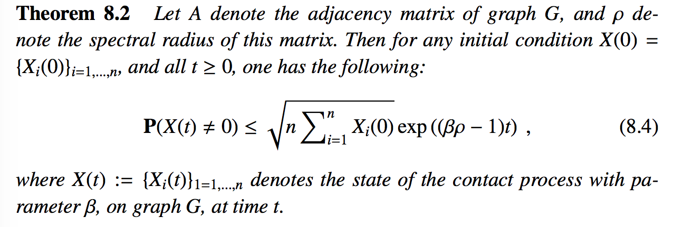
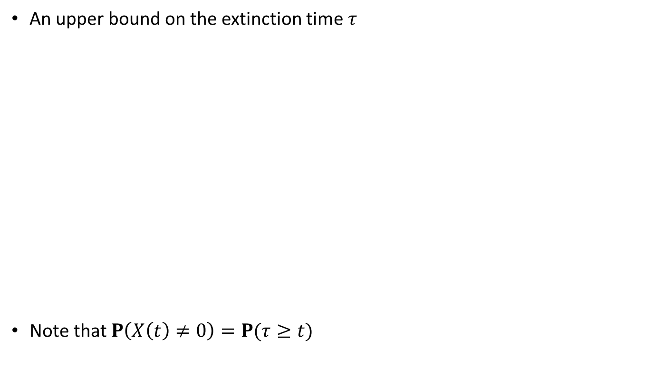
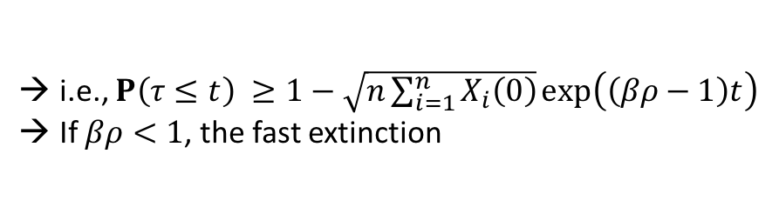
Analysis on Fast Extinction of SIS Model (1)
An upper bound on the extinction time $τ$
Note that $P\left(X\left(t\right)≠0\right)=P(τ≥t)$
i.e., $P\left(τ≤t\right) ≥1−\sqrt{n\sum_{i=1}^{n}{X_{i}\left(0\right)}}\exp\left(\left(βρ−1\right)t\right)$
If $βρ<1$, the fast extinction

Slide 13
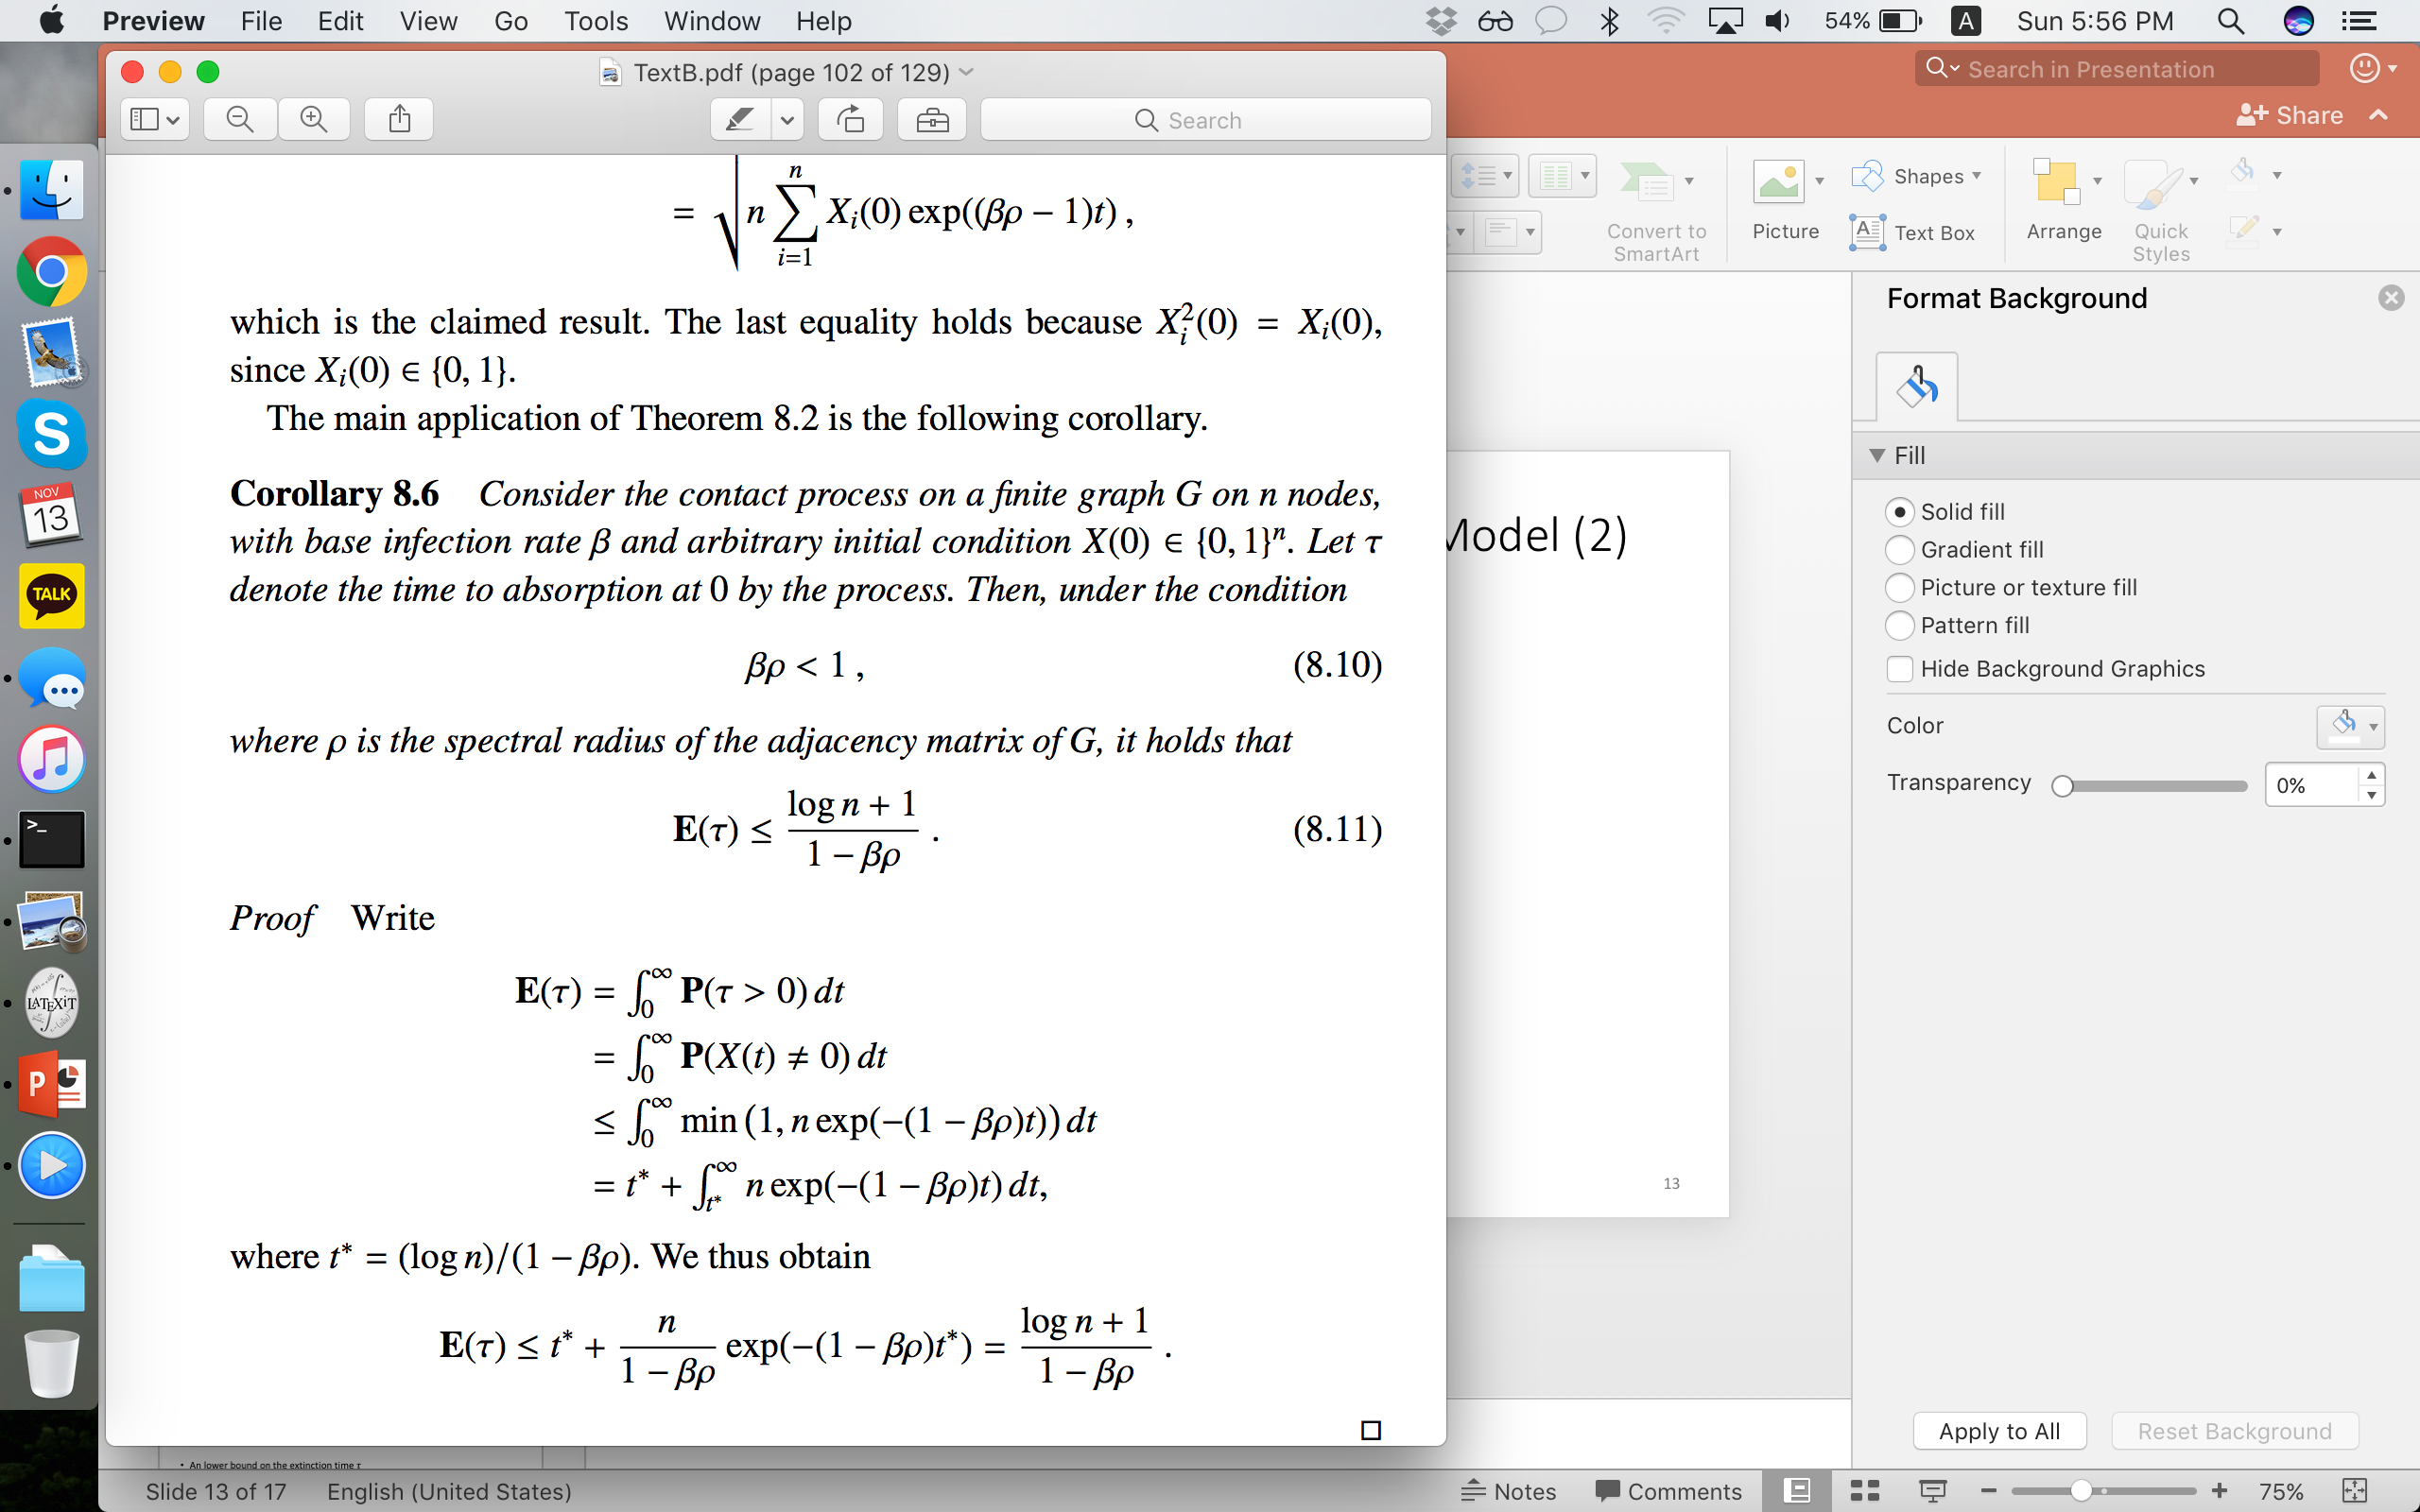
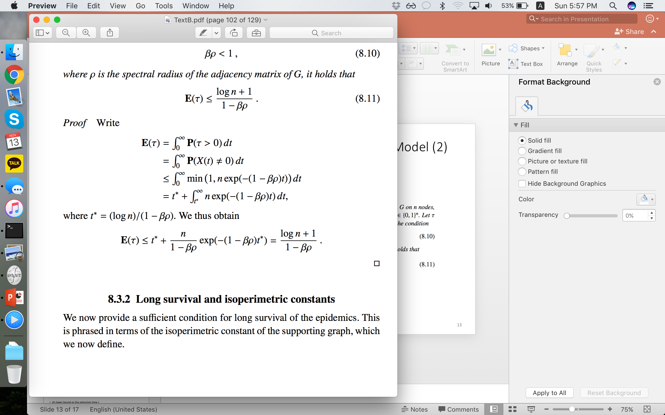

Analysis on Fast Extinction of SIS Model (2)
An upper bound on the extinction time $τ$
Fast extinction!
$$t$$

Slide 14
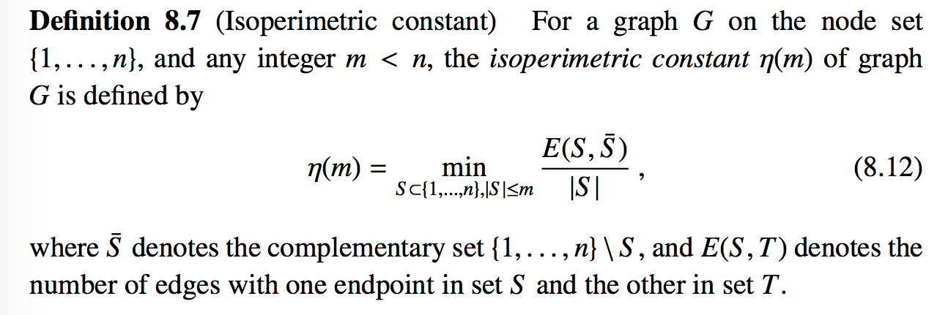
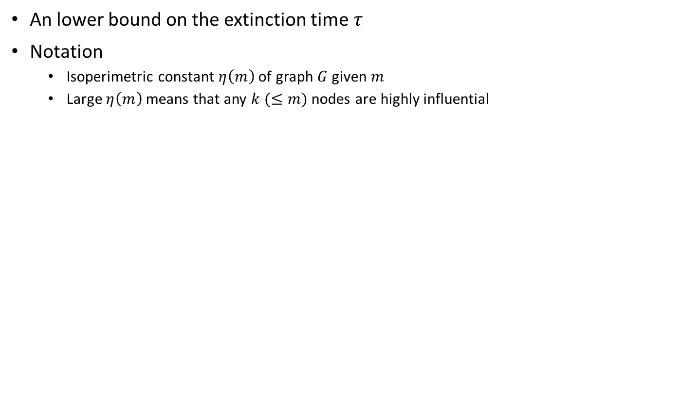
Analysis on Long Survival of SIS Model (1)
An lower bound on the extinction time $τ$
Notation
Isoperimetric constant $η\left(m\right)$ of graph $G$ given $m$
Large $η\left(m\right)$ means that any $k (≤m)$ nodes are highly influential

Slide 15
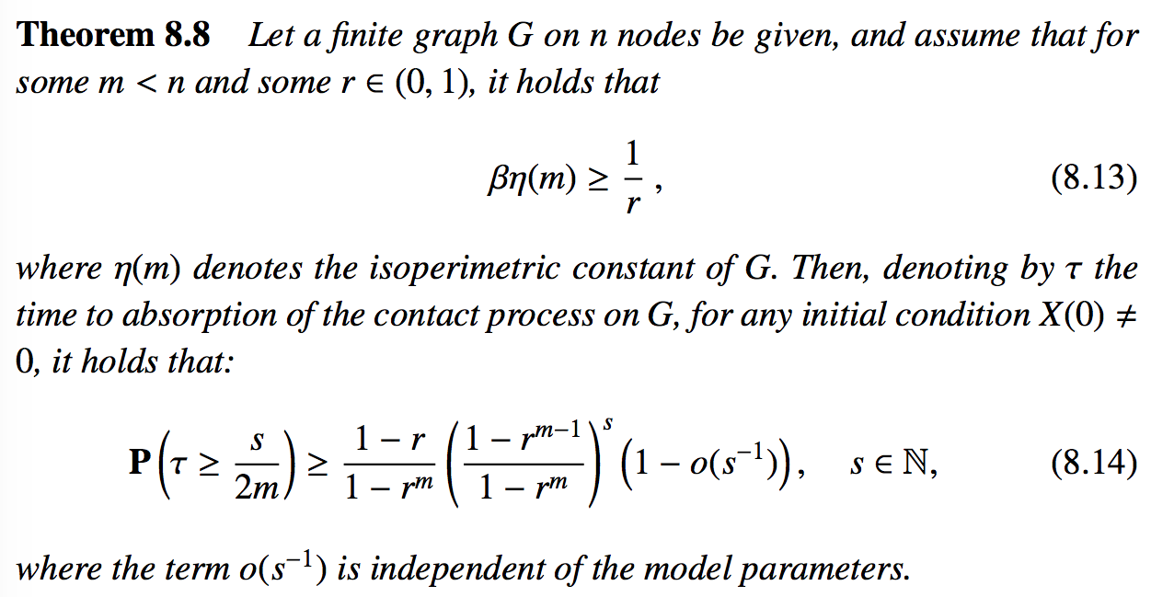

Analysis on Long Survival of SIS Model (2)
An lower bound on the extinction time $τ$

Slide 16
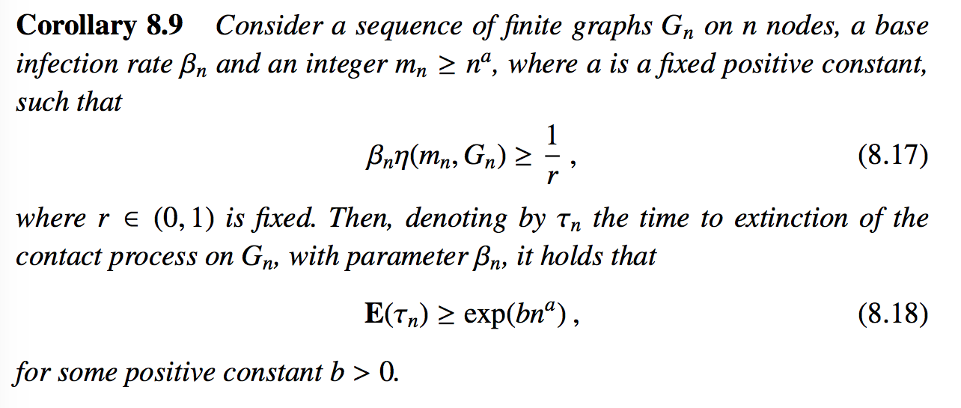
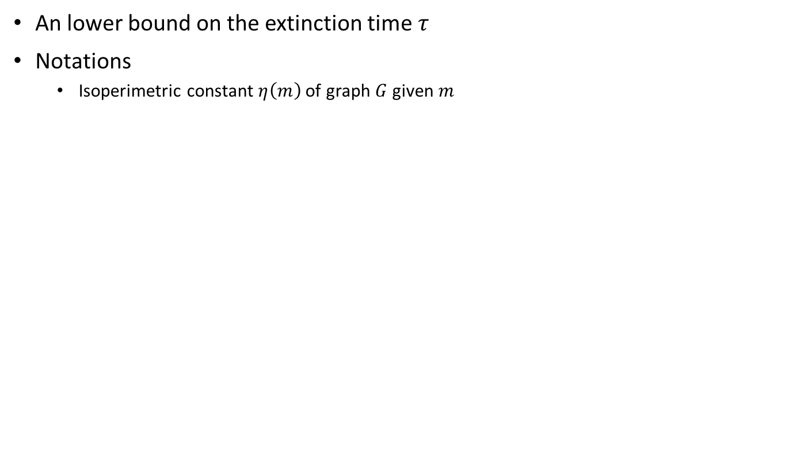
Analysis on Long Survival of SIS Model (3)
An lower bound on the extinction time $τ$
Notations
Isoperimetric constant $η\left(m\right)$ of graph $G$ given $m$
Proof) (Homework)

Slide 17
Outline
Two Classical Epidemic Models
S: susceptible, I: infected, R: removed
SIR model (a.k.a. Reed-Frost model)
SIS model
Analysis in General Graphs
Upper and lower bounds on degree of diffusion in terms of graph theoretic parameters and model parameters
SIR model: spread size
SIS model: extinction time
Analysis in Specific Graphs
Complete graph
E-R graph, star-shaped graph, hypercube graph

Slide 18
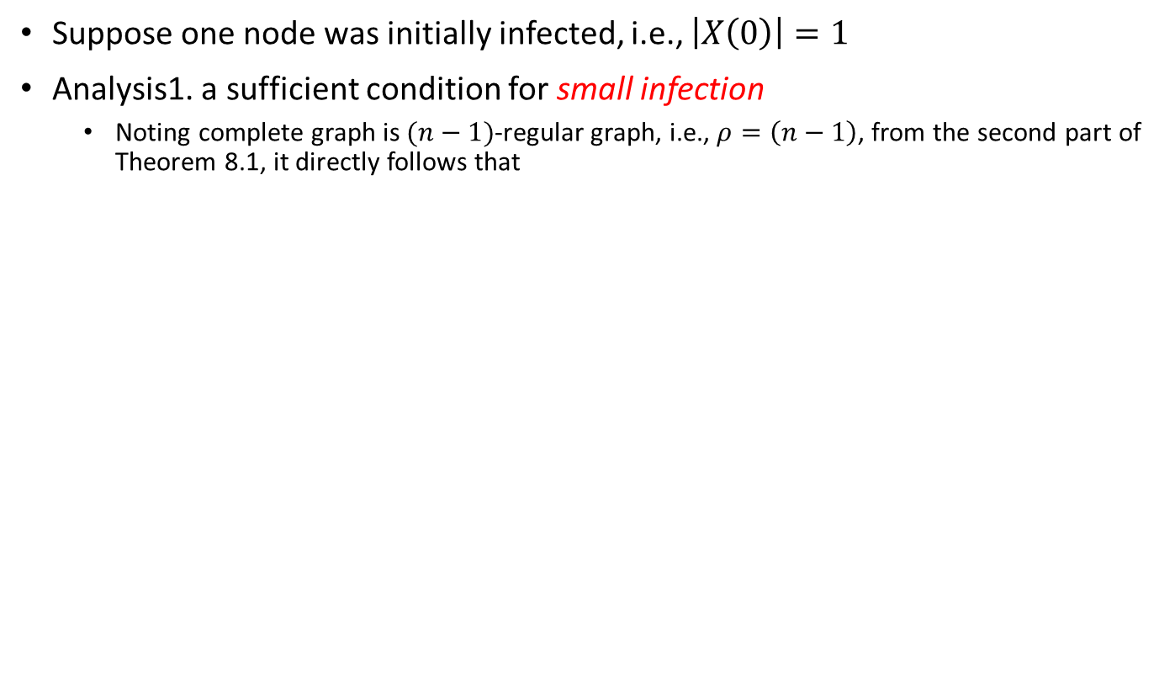

SIR Model in Complete Graph (1)
Suppose one node was initially infected, i.e., $\left|X\left(0\right)\right|=1$
Analysis1. a sufficient condition for small infection
Noting complete graph is $(n−1)$-regular graph, i.e., $ρ=\left(n−1\right)$, from the second part of Theorem 8.1, it directly follows that
If $β<\frac{1}{\left(n−1\right)}$, $E\left[\left|Y\left(∞\right)\right|\right]≤\frac{1}{1−β\left(n−1\right)}$

Slide 19
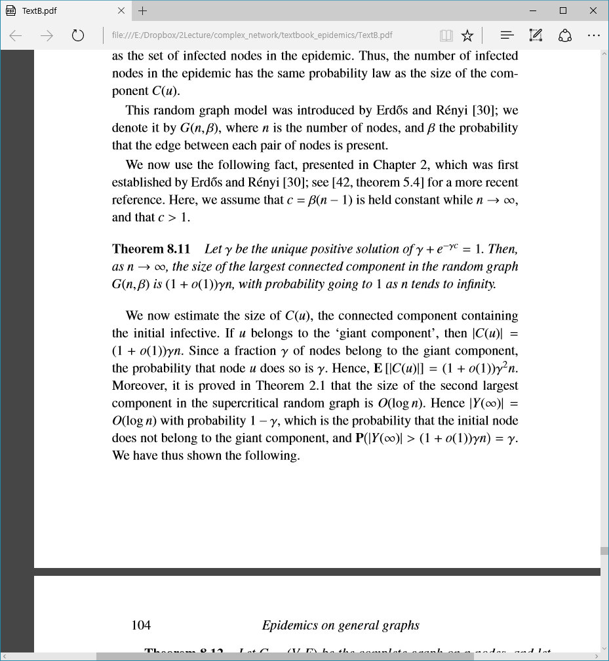
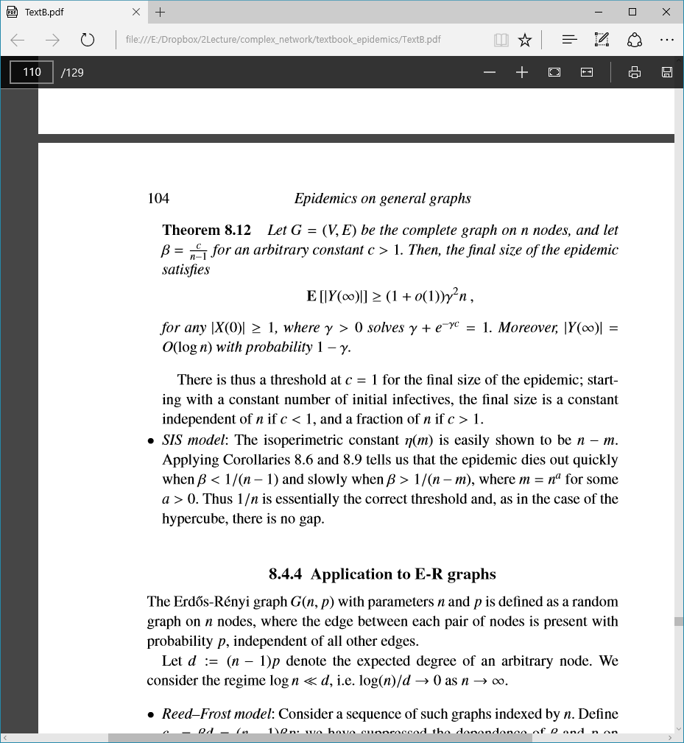
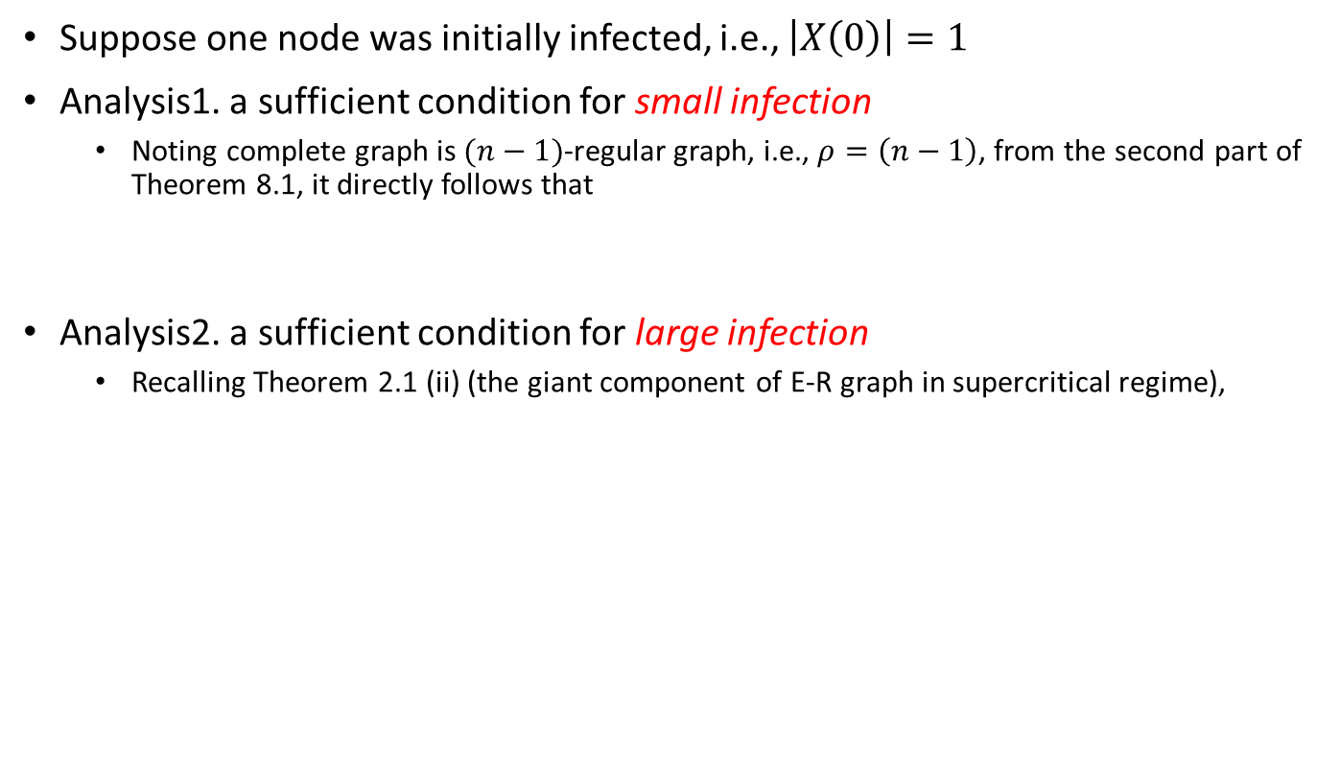
SIR Model in Complete Graph (2)
Suppose one node was initially infected, i.e., $\left|X\left(0\right)\right|=1$
Analysis1. a sufficient condition for small infection
Noting complete graph is $(n−1)$-regular graph, i.e., $ρ=\left(n−1\right)$, from the second part of Theorem 8.1, it directly follows that
Analysis2. a sufficient condition for large infection
Recalling Theorem 2.1 (ii) (the giant component of E-R graph in supercritical regime),
If $β<\frac{1}{\left(n−1\right)}$, $E\left[\left|Y\left(∞\right)\right|\right]≤\frac{1}{1−β\left(n−1\right)}$

Slide 20

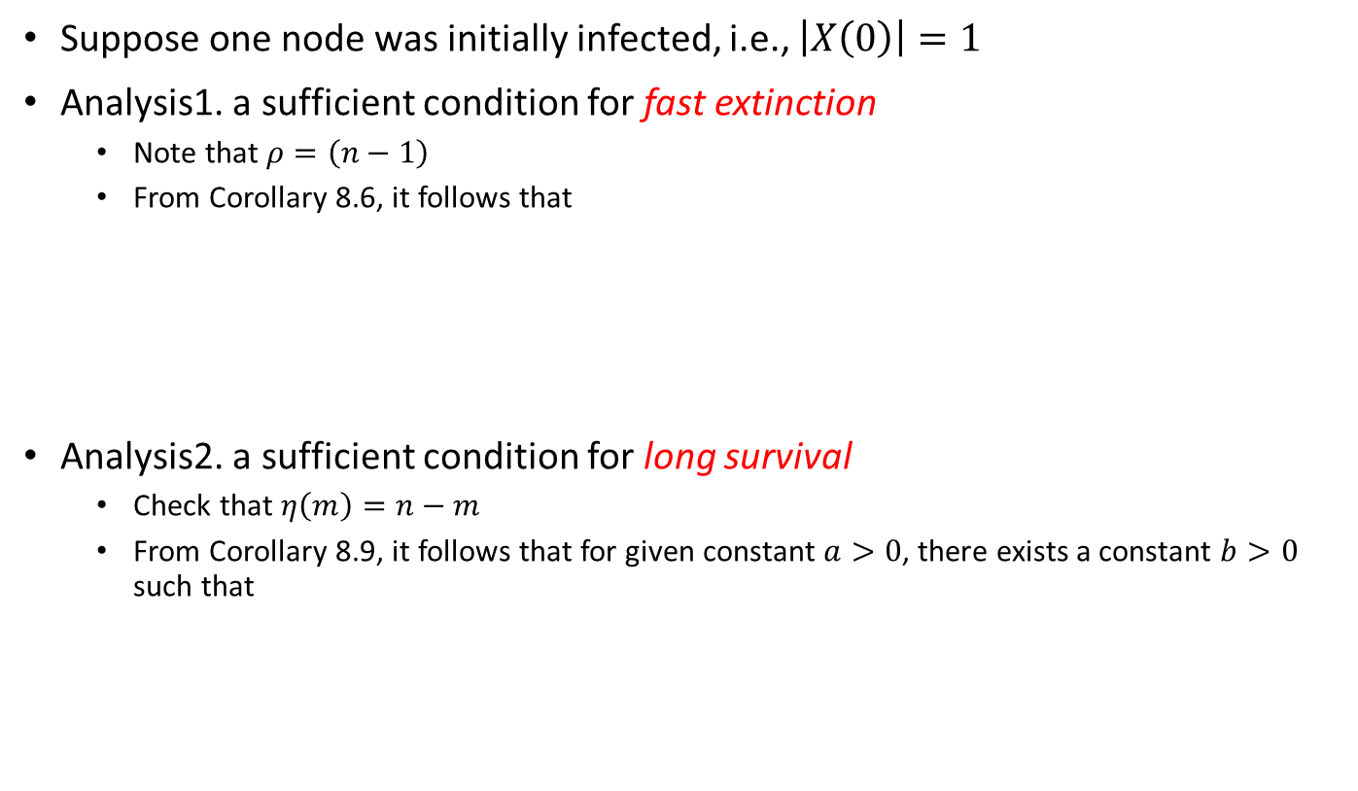

SIS Model in Complete Graph
Suppose one node was initially infected, i.e., $\left|X\left(0\right)\right|=1$
Analysis1. a sufficient condition for fast extinction
Note that $ρ=\left(n−1\right)$
From Corollary 8.6, it follows that
Analysis2. a sufficient condition for long survival
Check that $η\left(m\right)=n−m$
From Corollary 8.9, it follows that for given constant $a>0$, there exists a constant $b>0$ such that
If $β<\frac{1}{\left(n−1\right)}$, $E\left(τ\right)≤\frac{\log{n}+1}{1−β\left(n−1\right)}$
If $β>\frac{1}{\left(n−n^{a}\right)}$, $E\left(τ\right)≥\exp\left(bn^{a}\right)$

Slide 21
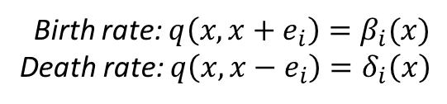
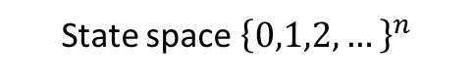
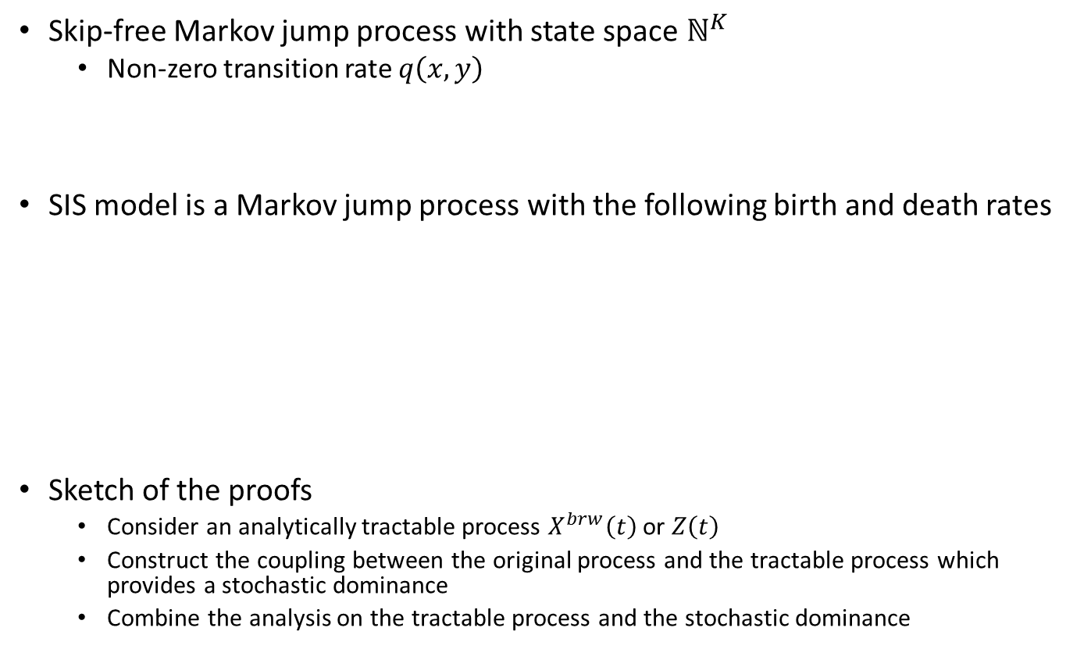
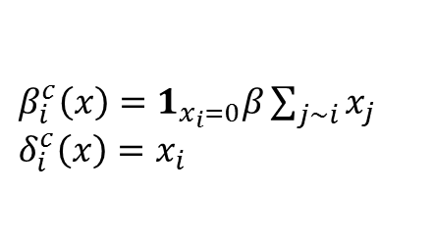
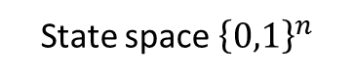
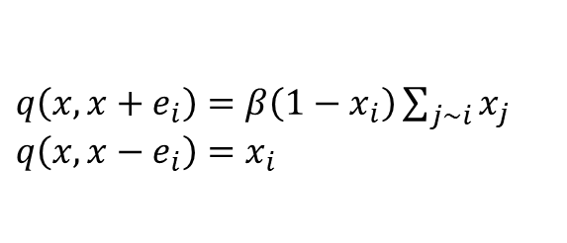
Preliminary to Proof of Theorems 8.2&8.8
Skip-free Markov jump process with state space $ℕ^{K}$
Non-zero transition rate $q\left(x, y\right)$
SIS model is a Markov jump process with the following birth and death rates
Sketch of the proofs
Consider an analytically tractable process $X^{brw}\left(t\right)$ or $Z\left(t\right)$
Construct the coupling between the original process and the tractable process which provides a stochastic dominance
Combine the analysis on the tractable process and the stochastic dominance
Birth rate: $q\left(x,x+e_{i}\right)=β_{i}(x)$
Death rate: $q\left(x,x−e_{i}\right)=δ_{i}\left(x\right)$
State space ${\left\{0,1\right\}}^{n}$
State space ${\left\{0,1,2,…\right\}}^{n}$
$q\left(x,x+e_{i}\right)=β\left(1−x_{i}\right)\sum_{j\sim i}{x_{j}}$
$q\left(x,x−e_{i}\right)=x_{i}$
$β_{i}^{c}\left(x\right)=1_{x_{i}=0}β\sum_{j\sim i}{x_{j}}$
$δ_{i}^{c}\left(x\right)=x_{i}$

Slide 22

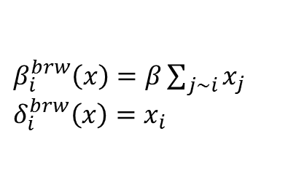
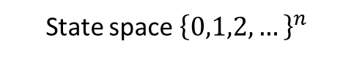
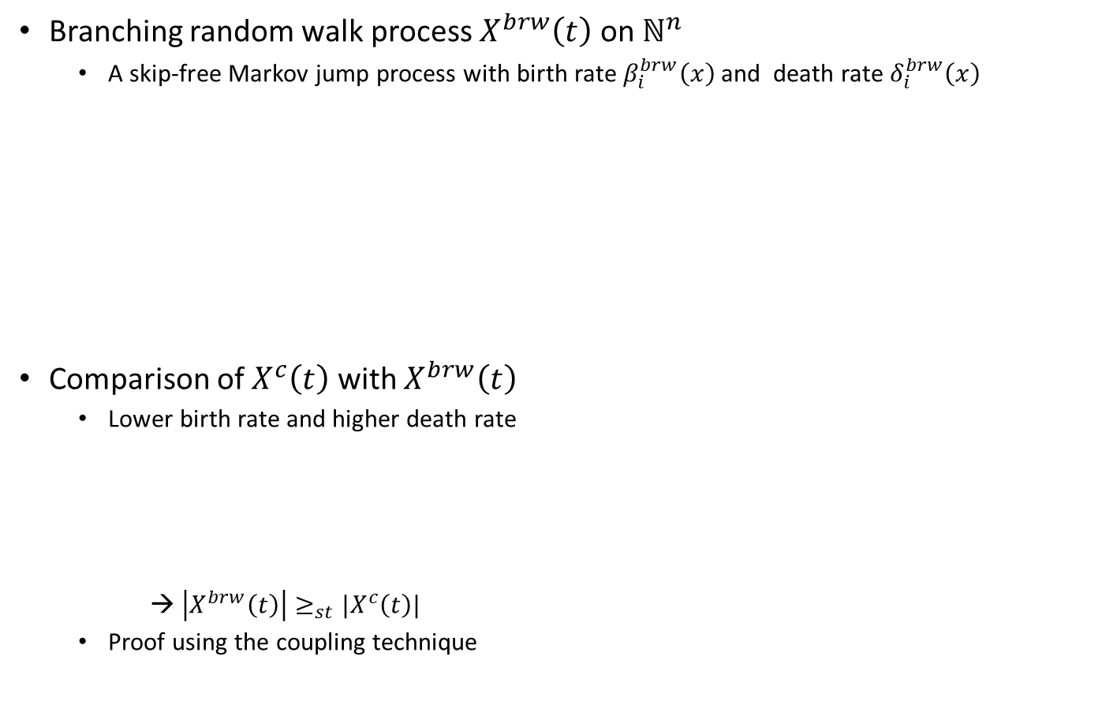
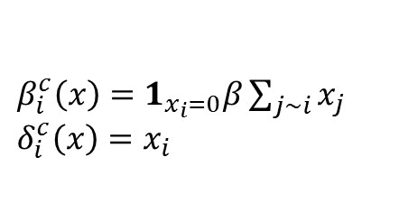

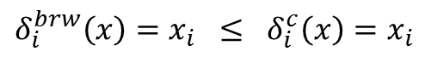
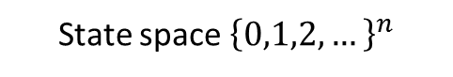
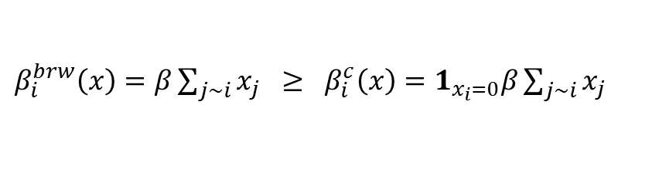
Proof of Theorem 8.2 (1)
Branching random walk process $X^{brw}\left(t\right)$ on $ℕ^{n}$
A skip-free Markov jump process with birth rate $β_{i}^{brw}\left(x\right)$ and death rate $δ_{i}^{brw}\left(x\right)$
Comparison of $X^{c}\left(t\right)$ with $X^{brw}\left(t\right)$
Lower birth rate and higher death rate
→ $\left|X^{brw}\left(t\right)\right|≥_{st}|X^{c}\left(t\right)|$
Proof using the coupling technique
Branching random walk $X^{brw}\left(t\right)$
SIS model $X^{c}\left(t\right)$
State space ${\left\{0,1,2,…\right\}}^{n}$
State space ${\left\{0,1,2,…\right\}}^{n}$
$β_{i}^{brw}\left(x\right)=β\sum_{j\sim i}{x_{j}}$
$δ_{i}^{brw}\left(x\right)=x_{i}$
$β_{i}^{c}\left(x\right)=1_{x_{i}=0}β\sum_{j\sim i}{x_{j}}$
$δ_{i}^{c}\left(x\right)=x_{i}$
$β_{i}^{brw}\left(x\right)=β\sum_{j\sim i}{x_{j}} ≥ β_{i}^{c}\left(x\right)=1_{x_{i}=0}β\sum_{j\sim i}{x_{j}}$
$δ_{i}^{brw}\left(x\right)=x_{i} ≤ δ_{i}^{c}\left(x\right)=x_{i}$

Slide 23
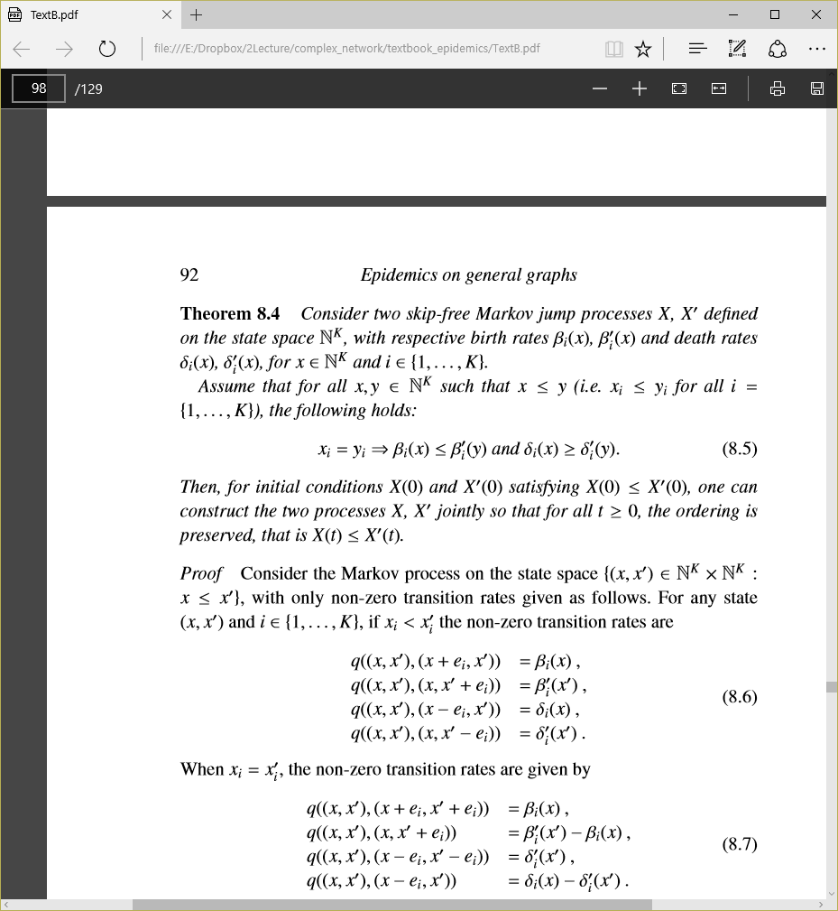
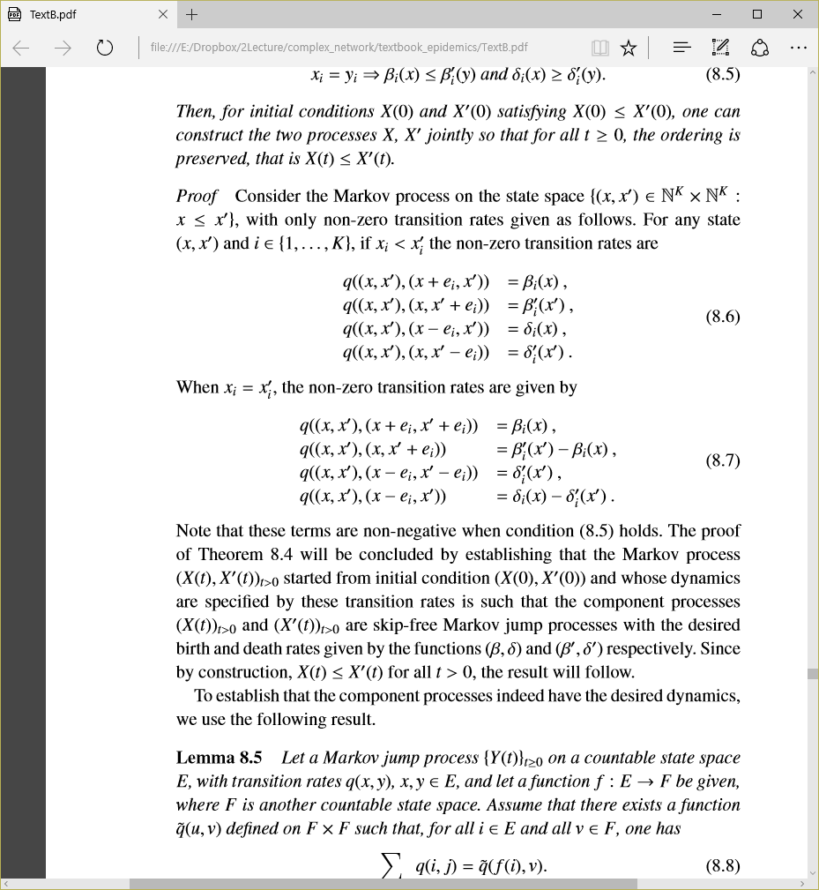
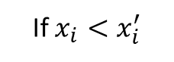
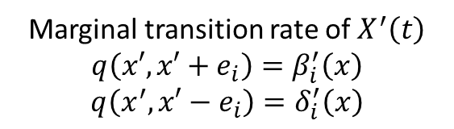



Stochastic Dominance from Coupling
i.e., $\left|X\left(t\right)\right|≤_{st}|X^{′}\left(t\right)|$
Proof by coupling $X\left(t\right)$ (or $X^{c}\left(t\right)$) and $X^{′}\left(t\right)$ (or $X^{brw}\left(t\right)$) as follows:
If $x_{i}<x_{i}^{′}$
If $x_{i}=x_{i}^{′}$
Marginal transition rate of $X\left(t\right)$
$q\left(x, x+e_{i}\right)=\sum_{x^{′},y^{′}}{q\left(\left(x,x^{′}\right),\left(x+e_{i}, y^{′}\right)\right)}=β_{i}\left(x\right)$
$q\left(x, x−e_{i}\right)=\sum_{x^{′},y^{′}}{q\left(\left(x,x^{′}\right),\left(x−e_{i}, y^{′}\right)\right)}=δ_{i}\left(x\right)$
Marginal transition rate of $X^{′}\left(t\right)$
$$q\left(x′, x′+e_{i}\right)=β_{i}^{′}\left(x\right)$$
$$q\left(x^{′}, x′−e_{i}\right)=δ_{i}^{′}\left(x\right)$$
A rigorous proof is provided in p.92-p.94 (Homework)

Slide 24




Proof of Theorem 8.2 (2)
The coupling construction with $X^{brw}\left(0\right)=X^{c}\left(0\right)=X\left(0\right)$ implies $X^{brw}\left(t\right)≥_{st}X^{c}\left(t\right)$, i.e.,
From the linear structure of the transition rates of the branching random walk,
where $\exp\left(X\right)=\sum_{k=0}^{∞}{\frac{1}{k!}X^{k}}$
See https://en.wikipedia.org/wiki/Matrix_differential_equation for details
By the Cauchy-Schwarz inequality,
$P\left(X^{c}\left(t\right)≠0\right) ≤ P\left(X^{brw}\left(t\right)≠0\right)$
$≤ e^{T}E\left(X^{brw}\left(t\right)\right)$
thus
$P\left(X^{c}\left(t\right)≠0\right) ≤e^{T}E\left(X^{brw}\left(t\right)\right)=e^{T}\exp\left(t\left(βA −I\right)\right)X\left(0\right)$
$≤\left\|e\right\|\left\|\exp\left(t\left(βA −I\right)\right)X\left(0\right)\right\|$

Slide 25


Proof of Theorem 8.2 (3)
Recalling the operator norm of a symmetric matrix is its spectral radius,
Summary of the proof
Consider the analytically tractable process $X^{brw}\left(t\right)$
Construct the coupling between $X^{brw}\left(t\right)$ and $X^{c}\left(t\right)$ providing the stochastic dominance
Combine the analysis on $X^{brw}(t)$ and the stochastic dominance to provide an upper bound of $P(τ≥t)$
Note) The proof of Theorem 8.8 will be similar to this proof but we are interested in a lower bound of $P\left(τ≥t\right)$ in Theorem 8.8
$P\left(X^{c}\left(t\right)≠0\right) ≤\left\|e\right\|\left\|\exp\left(t\left(βA −I\right)\right)X\left(0\right)\right\|$
$≤\left\|e\right\|\left|\exp\left(t\left(βρ−1\right)\right)\right|\left\|X\left(0\right)\right\|$
$=\sqrt{n\sum_{i=1 }^{n}{X_{i}^{2}\left(0\right)}}\exp\left(\left(βρ−1\right)t\right)$
$=\sqrt{n\sum_{i=1 }^{n}{X_{i}\left(0\right)}}\exp\left(\left(βρ−1\right)t\right)$

Slide 26








Proof of Theorem 8.8 (1)
Consider the Markov jump process $Z\left(t\right)$ on $\{0,1,…,m\}$, with non zero transition rates as follows:
Construct the joint process (or coupling) $(X,Z)$ on $\{\left(x,z\right)∈{\left\{0,1\right\}}^{n}×\left\{0,…,m\right\}, z≤\sum_{i=1}^{n}{x_{i}}\}$ with non-zero rates in the following:
$q\left(z,z+1\right)=r^{−1} z 1_{z<m}$
$q\left(z,z−1\right)=z$
If $\sum_{i=1}^{n}{x_{i}>z}$
If $\sum_{i=1}^{n}{x_{i}=z}$
Marginal transition rate of $X\left(t\right)$
$q\left(x, x+e_{i}\right)=\sum_{x^{′},y^{′}}{q\left(\left(x,x^{′}\right),\left(x+e_{i}, y^{′}\right)\right)}$
$=β\left(1−x_{i}\right)\sum_{j\sim i}{x_{j}}$
$q\left(x, x−e_{i}\right)=x_{i}$
Marginal transition rate of $Z\left(t\right)$
$q\left(z, z+1\right)=\left\{\begin{aligned}r^{−1} z 1_{z<m} if \sum_{i=1}^{n}{x_{i}>z} \\ \sum_{i=1}^{n}{c_{i}\left(x\right) }if \sum_{i=1}^{n}{x_{i}=z}\end{aligned}\right.$
$q\left(z, z−1\right)=z$

Slide 27


Proof of Theorem 8.8 (2)
We need to show the existence of $c_{i}(x)$ such that
i) Transition rate is non-negative
ii) Marginal transition rate of $Z\left(t\right)$
To show the existence of $c_{i}\left(x\right)$, it is enough to show
Let $S$ denote the set of nodes $j∈\{1,…,n\}$ such that $x_{j}=1$
Then, $\sum_{i=1}^{n}{β\left(1−x_{i}\right)}\sum_{j\sim i}{x_{j}}=βE \left(S, \overline{S}\right)$
Note that $\left|S\right|=\sum_{j}{x_{j}}=z≤m$
Hence, by the definition of isoperimetric constant and the assumption on $r$, $β\frac{E(S, \overline{S})}{|S|}≥βη\left(m\right)≥r^{−1}$

Slide 28





Proof of Theorem 8.8 (3)
From the construction of coupling $\left(X, Z\right)$, it follows that
To evaluate the right-hand side, consider the discrete-time Markov chain $Y\left(k\right)$ keeping track of the states visited by process $Z\left(t\right)$
Let $π_{k^{′}}$ denote the probability that starting from state $k^{′}∈\{0,…,m\}$, the chain $Y\left(k\right)$ hits $m$ before it is absorbed at $0$
$$P\left(τ>s\right) ≥ P(Z\left(s\right)=0)$$
(Homework)
→ $π_{k}=\frac{1−r^{k}}{1−r^{m}}$

Slide 29



Proof of Theorem 8.8 (4)
Then, we have
Also, after each entrance into state m, process $Z\left(t\right)$ remains there for an exponentially distributed random time, with mean $\frac{1}{m}$. Thus, if follows that
where the random variables $E_{i}$ are i.i.d., exponentially distributed with mean 1
From Chernoff’s Lemma 1.8,
The term $\exp\left(−sh_{exp}\left(\frac{1}{2}\right)\right)$ is clearly $o\left(s^{−1}\right)$
$$P\left({\left\{Y\left(k\right)\right\}}_{k≥0} visits state m at least s times\right)≥\frac{1−r}{1−r^{m}}{\left(\frac{1−r^{m−1}}{1−r^{m}}\right)}^{s}$$
where

Slide 30

Homework
Prove the second part of Theorem 8.1
Prove Corollary 8.9
Prove Theorem 8.4
Show
→ $π_{k}=\frac{1−r^{k}}{1−r^{m}}$

